Slide 1

Increase Results
with

Slide 2
Customer Acquisition Process
Awareness
Consideration
Evaluation
MQL
SQL
Opportunity
Revenue
Demand Gen
Nurture
Engage
Service
Marketing Automation
Readiness and Enablement
Customer Experience
5
3
1

Slide 3
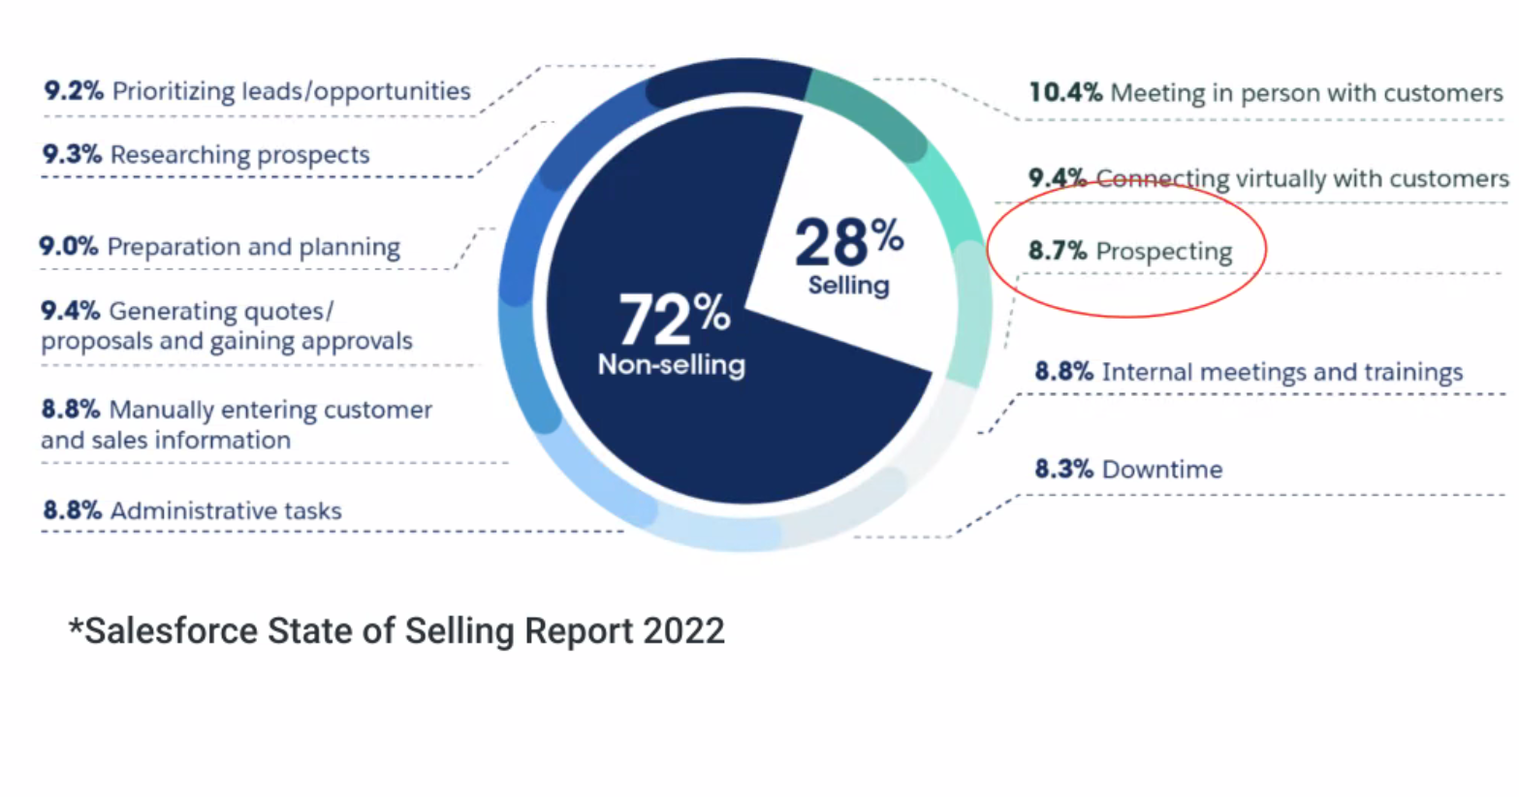
Sales Teams Have Limited Time to Sell
9.2%
Prioritizing leads/opportunities
10.4%
Meeting in person with customers
9.3%
Researching prospects
9.4%
Connecting virtually with customers
9.0%
Preparation and planning
8.7%
Prospecting
v
9.4%
Generating quotes/
Proposals and gaining approvals
8.8%
Internal meetings and trainings
8.8%
Manually entering customer
and sales information
8.3%
Downtime
8.8%
Administrative tasks

Slide 4


Data is the New Oil…
But Knowledge is the Fuel
INSTITUTIONAL KNOWLEDGE
PRODUCT KNOWLEDGE
SALES KNOWLEDGE
SITUATIONAL KNOWLEDGE
TRIBAL KNOWLEDGE
Notes:
Institutional Knowledge – How do I work this, how do I find this,
Product Knowledge – How does it work, how do you use it, what does it do
Sales Knowledge – Technique – how do prospect, how to negotiate
Selling Knowledge – What do I say, under what circumstances

Slide 5
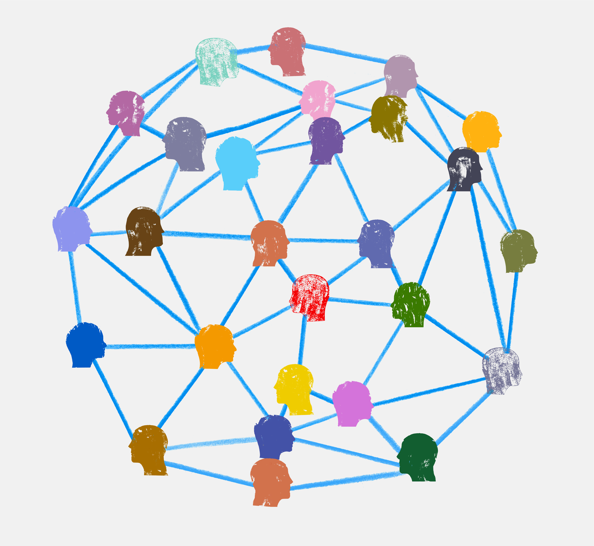

The Sales Knowledge Network
Access
To
Experts
Sales
Training
Customer
Research
Product
Training
Contextual and AI Supported Access
Learning
Coaching
Support
Market
Research
Administrative
Tools
Engagement
Content
Opportunity
Data

Slide 6

From Chaos to Convergence
LEVELS OF KNOWLEDGE MANAGEMENT MATURITY
LEVEL
V
Innovate
Continuously
improving practices
LEVEL
lV
Optimize
DYNAMIC
KNOWLEDGE
Measured and
adaptive
LEVEL
lll
Standardize
LEVERAGED
KNOWLEDGE
Common processes
and approaches
LEVEL
ll
Develop
APPLIED
KNOWLEDGE
Localized and repeatable practices
LEVEL
l
Initiate
AD HOC
KNOWLEDGE
Growing
Awareness

Slide 7





















SUSPECTS
Goal: Brand Awareness
LEADS
Goal: Product Knowledge
OPPORTUNITIES
Goal: Closed Contract
Demos
ROI Tools
eMail
Webinars
New Rules of Selling
Over 70% of B2B decision makers prefer remote interactions or digital self-service
Leads come from meeting customers on-line – LinkIn and Twitter
They must use client specific and industry focused solution selling
Direct
Contact
Pricing
Case Studies
Events (Virtual)
Website
Community
Conversation Support
Social
Articles
Testimonials
Press Releases
eBooks
Training
Readiness
Videos
Sales and Services
Newsletters
White Papers
Blogs
Infographics
https://hbr.org/2021/06/the-new-rules-of-b2b-lead-generation

Slide 8




The Pathway to Competency
Engage Sellers
Create Awareness
Promote learning
Ensure Understanding
Facilitate Practice
Support Performance
SUPPORT PERFORMANCE
FACILITATE PRACTICE
ENSURE UNDERSTANDING
PROMOTE
LEARNING
CREATE
AWARENESS
ENGAGE
SELLERS

Slide 9
Selling is hard… Really hard

Slide 10
The Pathway to Competency
Engage Sellers
Create Awareness
Promote learning
Ensure Understanding
Facilitate Practice
Support Performance
SUPPORT PERFORMANCE
FACILITATE PRACTICE
ENSURE UNDERSTANDING
PROMOTE
LEARNING
CREATE
AWARENESS
ENGAGE
SELLERS
COMMUNITY
LEARNING
GUIDED PRACTICE
CONTENT IN CONTEXT
COMMUNICATION AND CONTINOUS COACHING
AWARENESS, UNDERSTANDING
& RETENTION
REINFORCEMENT & APPLICATION OF KNOWLEDGE
KNOWLEDGE, CONTENT, TOOLS & ASSISTANCE

Slide 11
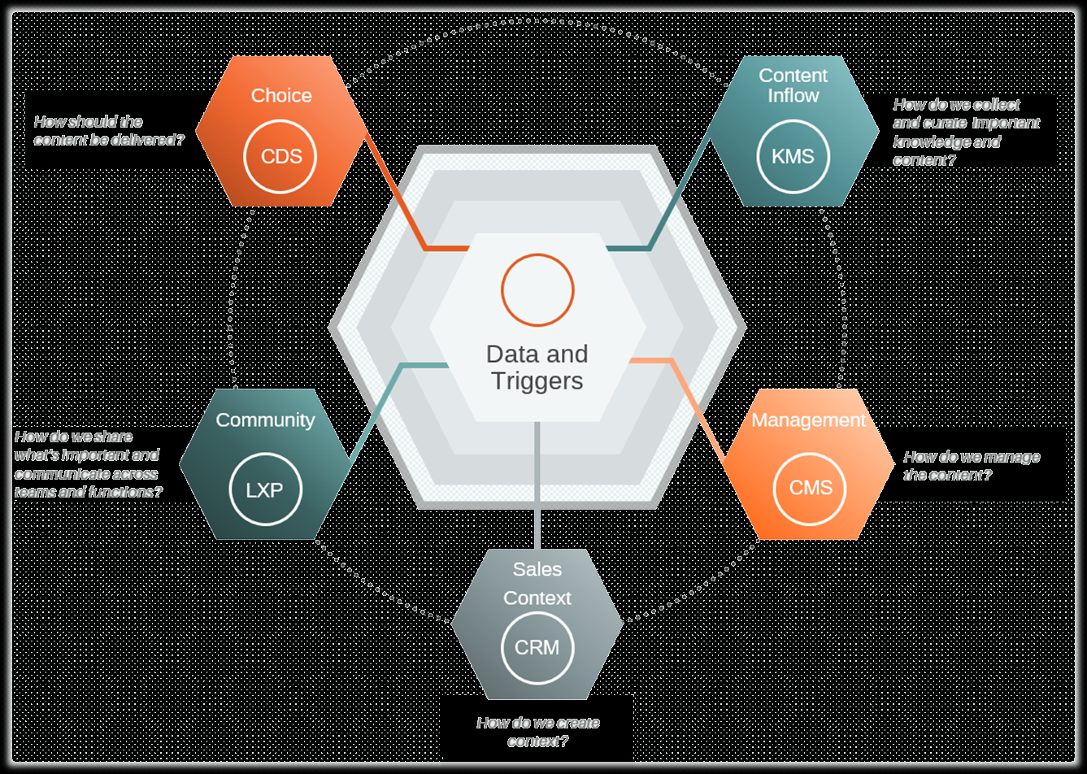
CRM for customer data insights
Engagement Platform
Community learning and knowledge sharing platform
Ongoing sales knowledge and development
Product knowledge and industry training
Selling skills
Well Defined Goals and Objectives
Aligned to overall Business Objectives
Clear Strategy on how to achieve them
Content People Process
Notes:
TEG Sales Readiness & Enablement House
Foundation: Strategy and Goals
Clear sales enablement strategy
Well-defined goals and objectives
Alignment with overall business objectives
Pillar 1: Content Development
Creation of relevant and engaging sales content
Sales collateral (brochures, presentations, case studies)
Product and solution documentation
Pillar 2: Knowledge
Ongoing sales knowledge and development
Product knowledge and industry training
Selling skills
Pillar 3: Data & Technology
CRM for customer data insights
Engagement platform
Pillar 4: Collaboration and Communication
Cross-functional collaboration between sales, marketing, and product teams
Internal communication channels
Community knowledge sharing platforms
Pillar 5: Performance Measurement
Data, Key performance indicators (KPIs) tracking
Regular assessment of sales team performance
Optimization and continuous improvement
Rafters:
Omnichannel customer interaction/engagement
Roof: Customer Experience

Slide 12




Evolution of Readiness
KNOWLEDGE NETWORK
SOCIAL
Employee Driven
Organic
Interactive
Just-in-Time
Video/Documents/Social
Knowledge Sharing
Expertise Finder
Social LMS
YouTube Enterprise
Facebook Enterprise
Microblogging
BLENDED
Trainer
&
LMS
ELEARNING
CLASSROOM
Online
Courses
(LMS)
Trainer
Formal Learning
Informal Learning
“ I HAVE to learn”
“I WANT to learn”

Slide 13
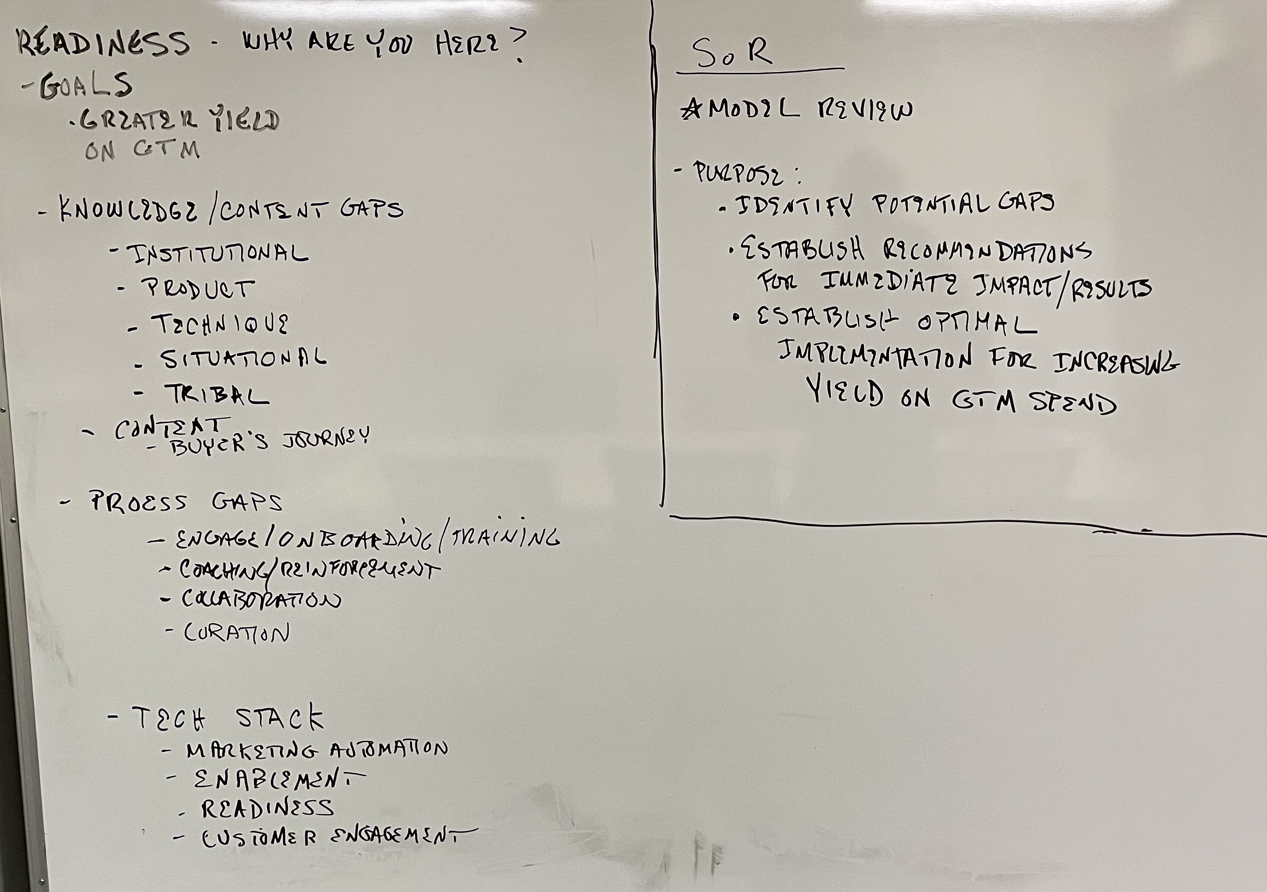
Map
Recommendation engine

Slide 14
Readiness (Everboarding) Cycle
Feedback
Initial
Assessment
Assigned
Journey
Understanding
Continuous
Challenges
Learning
Assignment
Coaching
Performance
Support
Feedback

Slide 15
CRM for customer data insights
Engagement Platform
Community learning and knowledge sharing platform
Ongoing sales knowledge and development
Product knowledge and industry training
Selling skills
Well Defined Goals and Objectives
Aligned to overall Business Objectives
Clear Strategy on how to achieve them
Content People Process
Notes:
TEG Sales Readiness & Enablement House
Foundation: Strategy and Goals
Clear sales enablement strategy
Well-defined goals and objectives
Alignment with overall business objectives
Pillar 1: Content Development
Creation of relevant and engaging sales content
Sales collateral (brochures, presentations, case studies)
Product and solution documentation
Pillar 2: Knowledge
Ongoing sales knowledge and development
Product knowledge and industry training
Selling skills
Pillar 3: Data & Technology
CRM for customer data insights
Engagement platform
Pillar 4: Collaboration and Communication
Cross-functional collaboration between sales, marketing, and product teams
Internal communication channels
Community knowledge sharing platforms
Pillar 5: Performance Measurement
Data, Key performance indicators (KPIs) tracking
Regular assessment of sales team performance
Optimization and continuous improvement
Rafters:
Omnichannel customer interaction/engagement
Roof: Customer Experience

Slide 16
Readiness Platform
Feedback
Content
Creation
Assessments
And
Assignements
Understanding
Continuous
Challenges
Learning
Assignment
Coaching
Performance
Support
Feedback

Slide 17
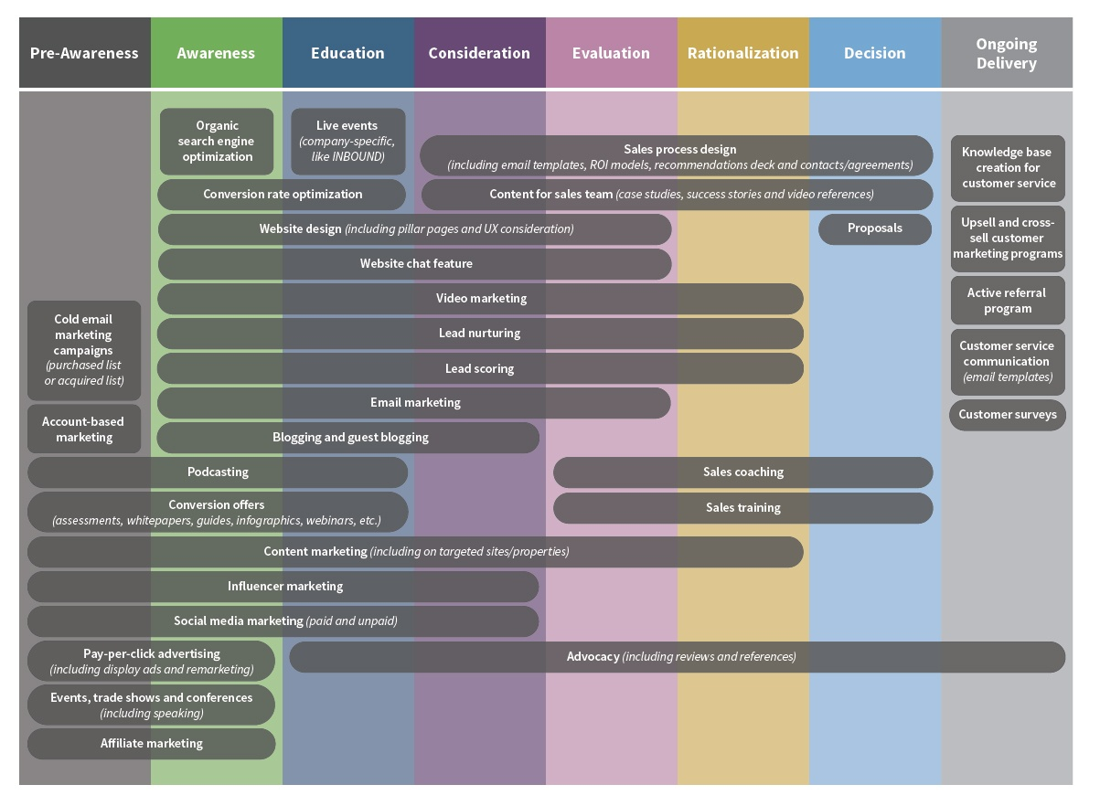
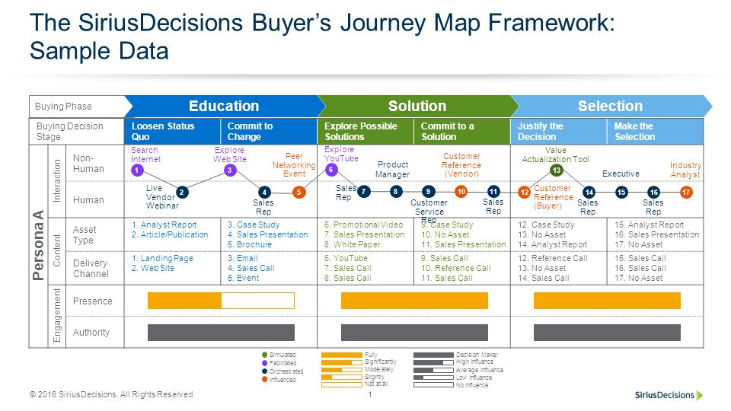
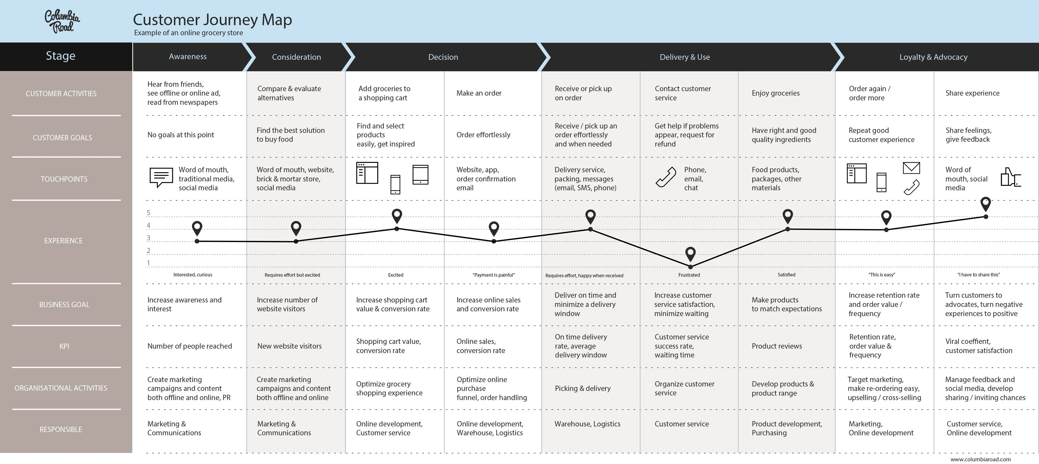

Slide 18
Strategy
Substance
Workflow
CORE
STRATEGY
Structure
Governance
Content Components
People Components

Slide 19
Are You Ready?
Customer Experience
Integrated Engagement Platform
Content
Development
Collaboration
and
Communication
Performance
Measurement
CRM for customer data insights
Engagement Platform
Community learning and knowledge sharing platform
Creation of relevant and engaging sales content
Sales collateral
Product and solution documentation
Cross-functional collaboration between sales, marketing and product teams
Internal communication channels
Feedback systems
Key Performance Indicators (KPIs) tracking
Regular assessment of team performance
Optimization and continuous improvement
Ongoing sales knowledge and development
Product knowledge and industry training
Selling skills
Well Defined Goals and Objectives
Aligned to overall Business Objectives
Clear Strategy on how to achieve them
Knowledge Management
Goals and Strategy
Content People Process
Notes:
TEG Sales Readiness & Enablement House
Foundation: Strategy and Goals
Clear sales enablement strategy
Well-defined goals and objectives
Alignment with overall business objectives
Pillar 1: Content Development
Creation of relevant and engaging sales content
Sales collateral (brochures, presentations, case studies)
Product and solution documentation
Pillar 2: Knowledge
Ongoing sales knowledge and development
Product knowledge and industry training
Selling skills
Pillar 3: Data & Technology
CRM for customer data insights
Engagement platform
Pillar 4: Collaboration and Communication
Cross-functional collaboration between sales, marketing, and product teams
Internal communication channels
Community knowledge sharing platforms
Pillar 5: Performance Measurement
Data, Key performance indicators (KPIs) tracking
Regular assessment of sales team performance
Optimization and continuous improvement
Rafters:
Omnichannel customer interaction/engagement
Roof: Customer Experience

Slide 20
The Pathway to Competency
Engage Sellers
Create Awareness
Promote learning
Ensure Understanding
Facilitate Practice
Support Performance
SUPPORT PERFORMANCE
FACILITATE PRACTICE
ENSURE UNDERSTANDING
PROMOTE
LEARNING
CREATE
AWARENESS
ENGAGE
SELLERS

Slide 21
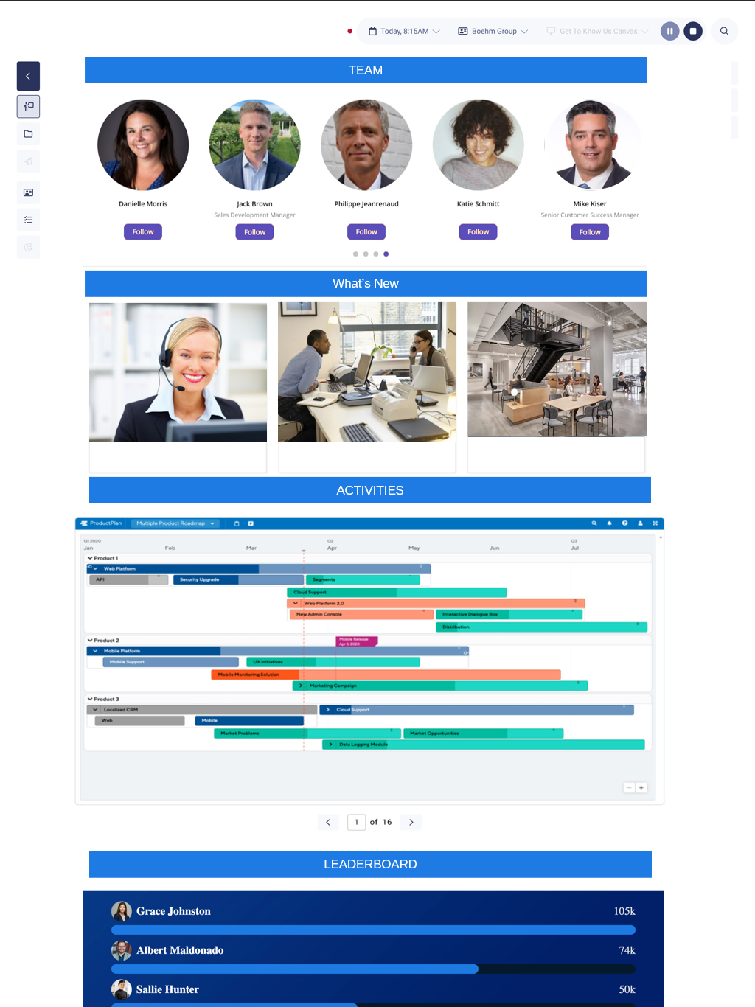
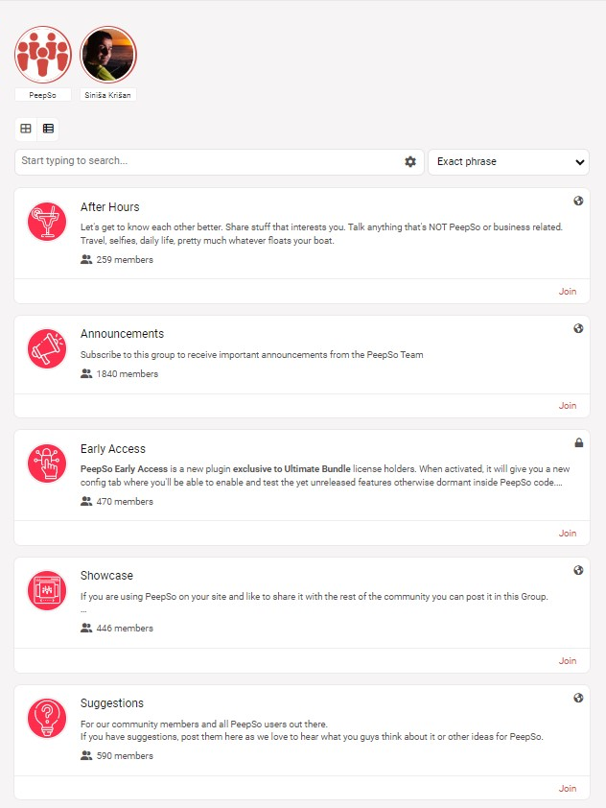
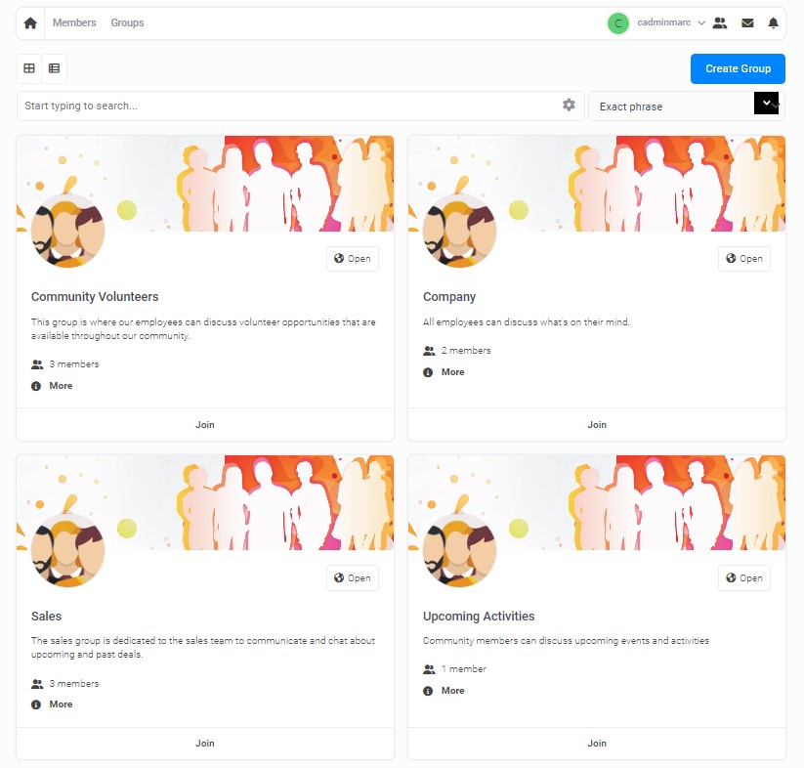
The Pathway to Competency
Engage Sellers
Create Awareness
Promote learning
Ensure Understanding
Facilitate Practice
Support Performance
SUPPORT PERFORMANCE
FACILITATE PRACTICE
ENSURE UNDERSTANDING
PROMOTE
LEARNING
CREATE
AWARENESS
ENGAGE
SELLERS
COMMUNITY
COMMUNICATION AND CONTINOUS COACHING

Slide 22
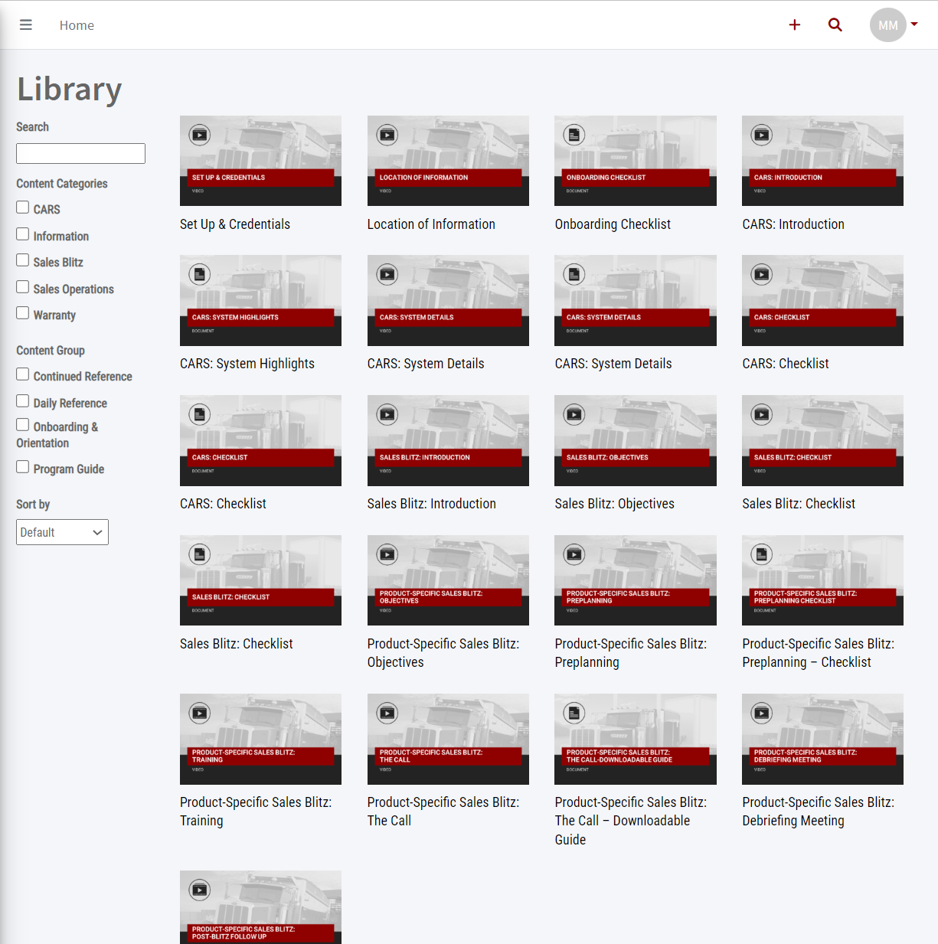
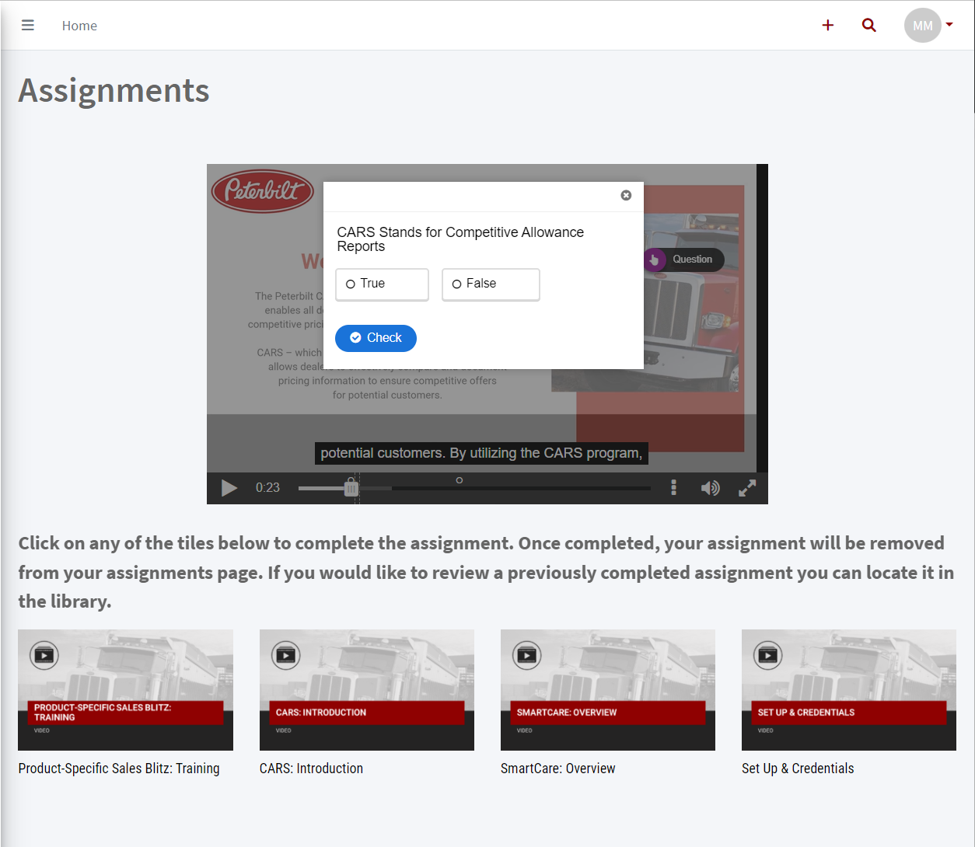
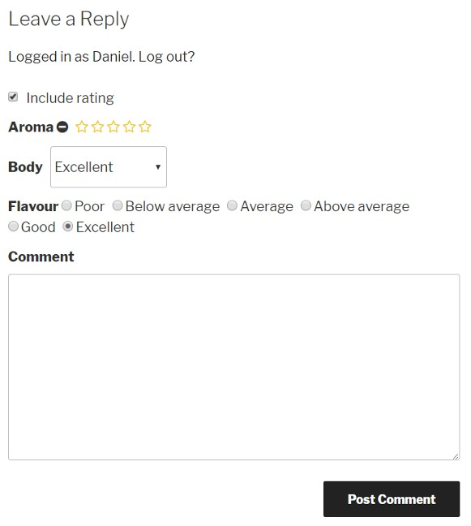
The Pathway to Competency
Engage Sellers
Create Awareness
Promote learning
Ensure Understanding
Facilitate Practice
Support Performance
SUPPORT PERFORMANCE
FACILITATE PRACTICE
ENSURE UNDERSTANDING
PROMOTE
LEARNING
CREATE
AWARENESS
ENGAGE
SELLERS
COMMUNITY
LEARNING
COMMUNICATION AND CONTINOUS COACHING
AWARENESS, UNDERSTANDING
& RETENTION

Slide 23

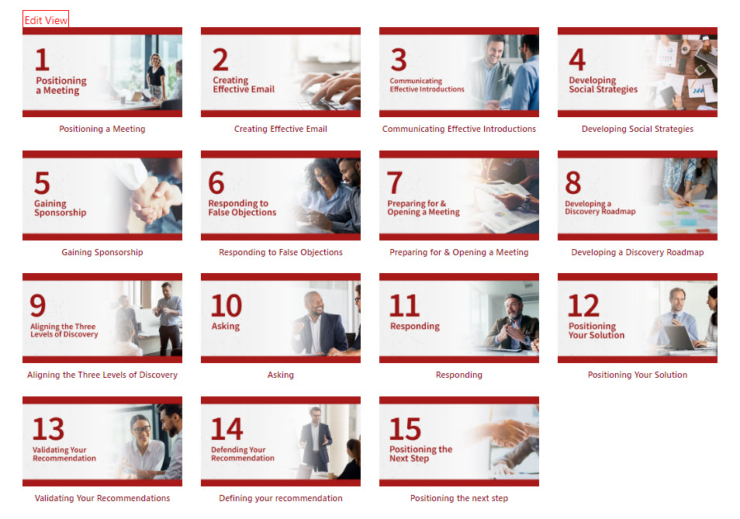
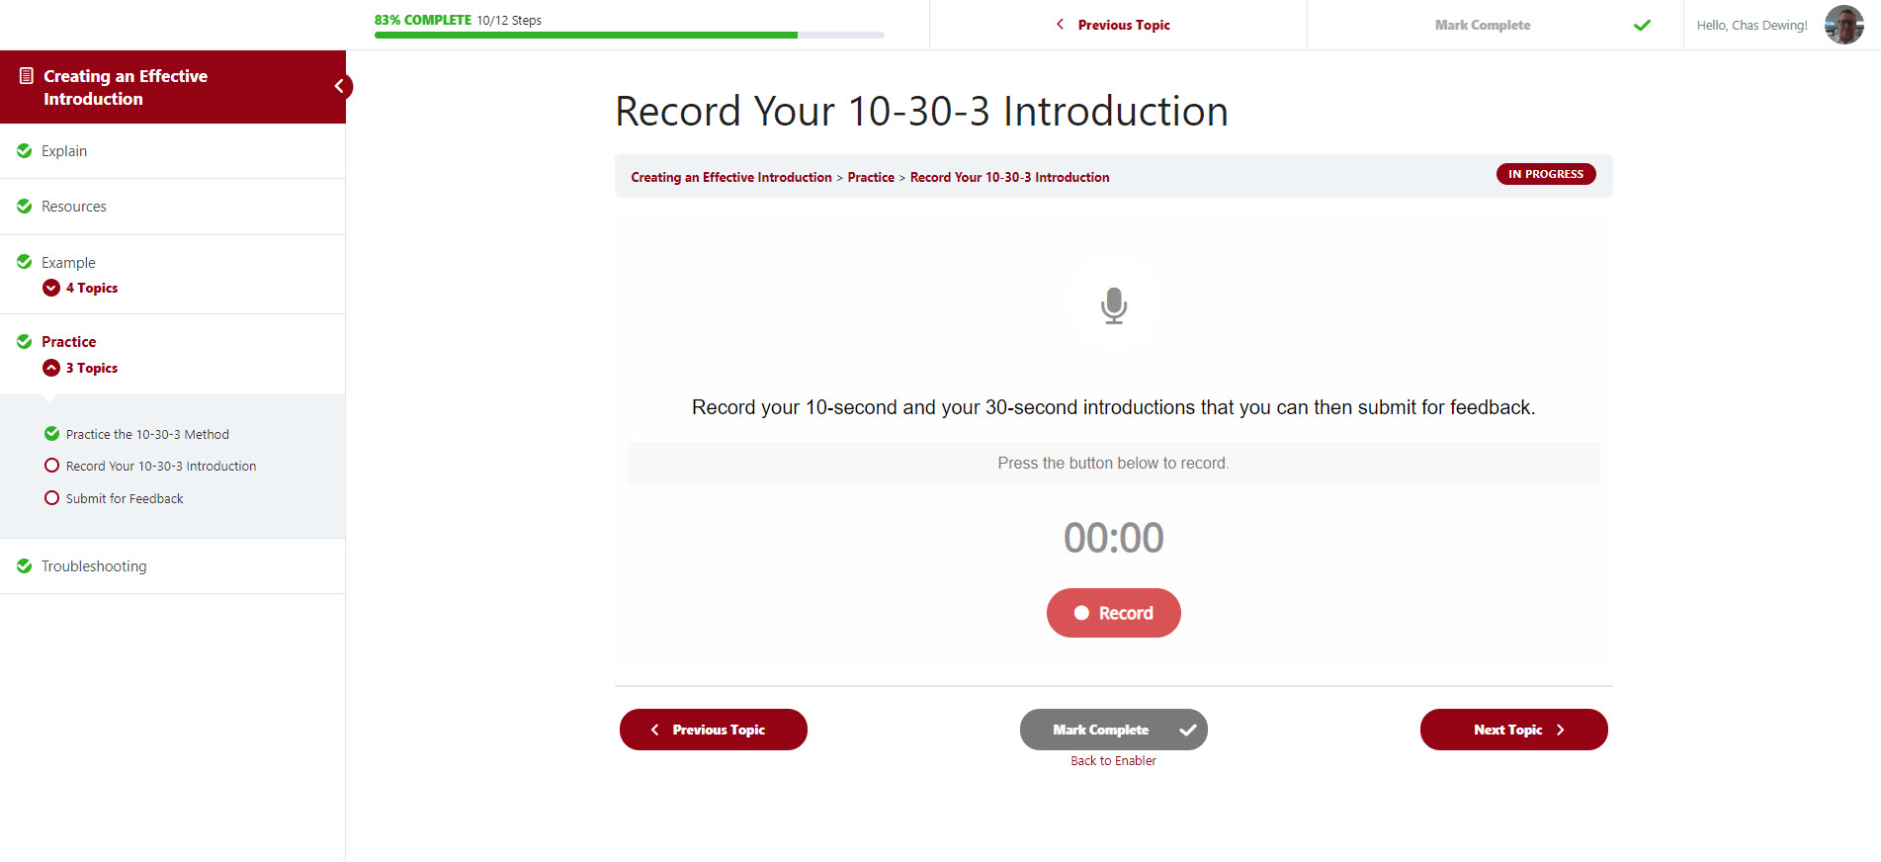
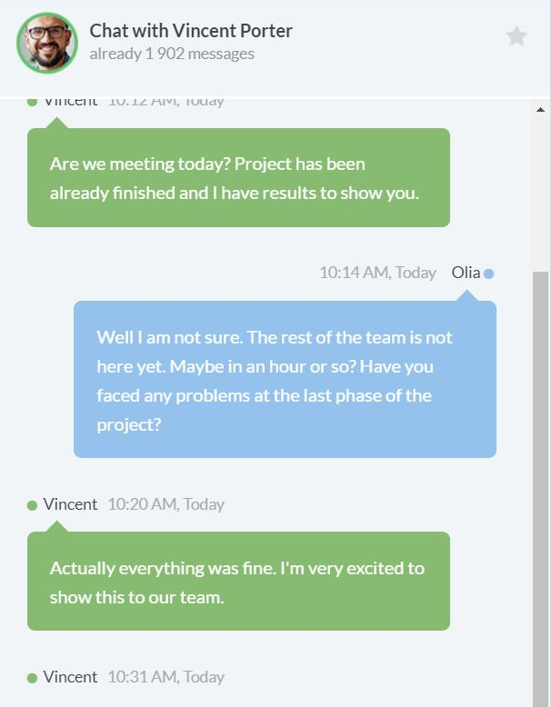
The Pathway to Competency
Engage Sellers
Create Awareness
Promote learning
Ensure Understanding
Facilitate Practice
Support Performance
SUPPORT PERFORMANCE
FACILITATE PRACTICE
ENSURE UNDERSTANDING
PROMOTE
LEARNING
CREATE
AWARENESS
ENGAGE
SELLERS
Contact Your Coach
COMMUNITY
LEARNING
GUIDED PRACTICE &
COACHING
COMMUNICATION AND CONTINOUS COACHING
AWARENESS, UNDERSTANDING
& RETENTION
REINFORCEMENT & APPLICATION OF KNOWLEDGE

Slide 24
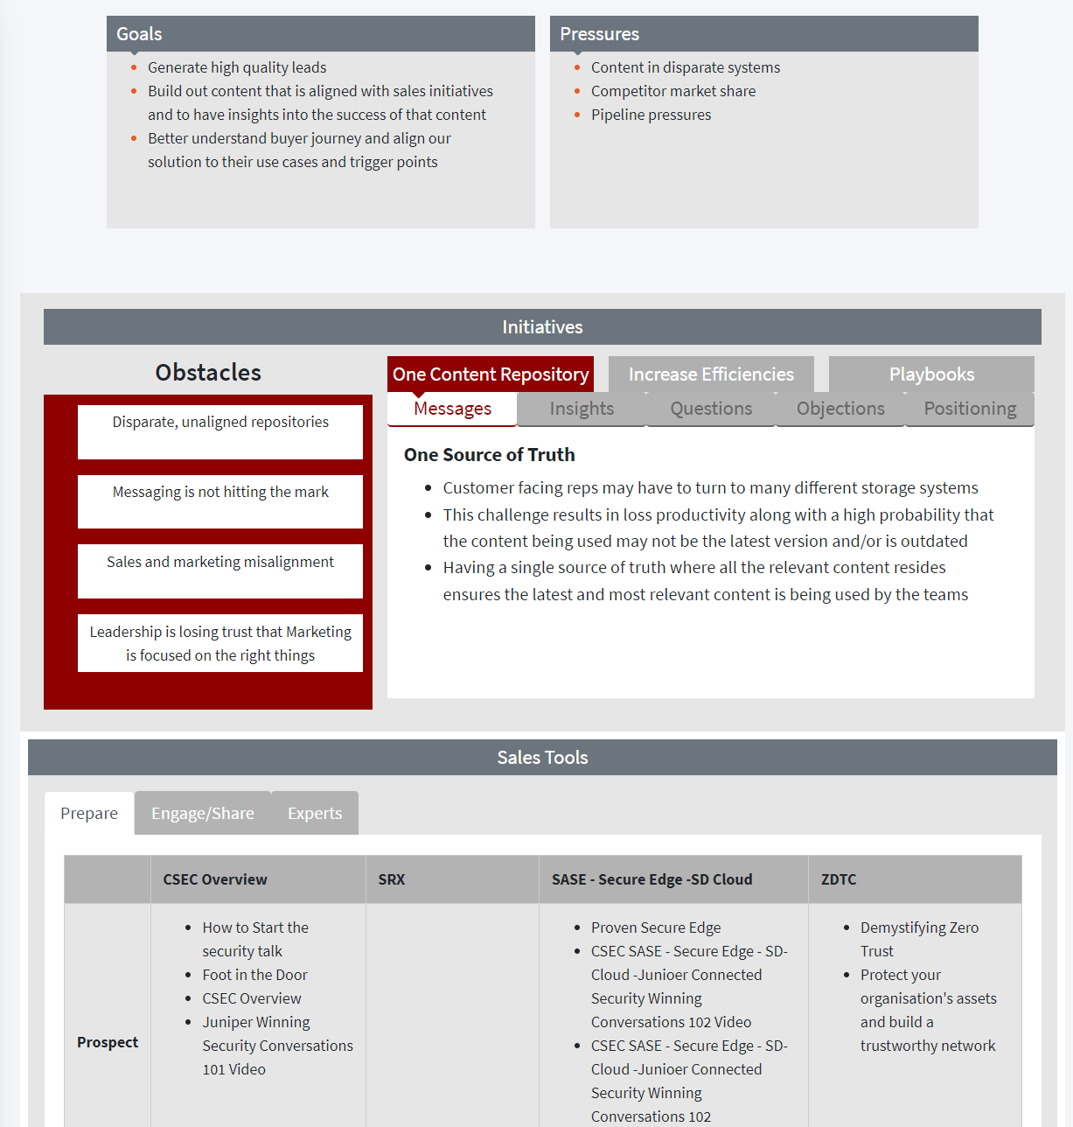
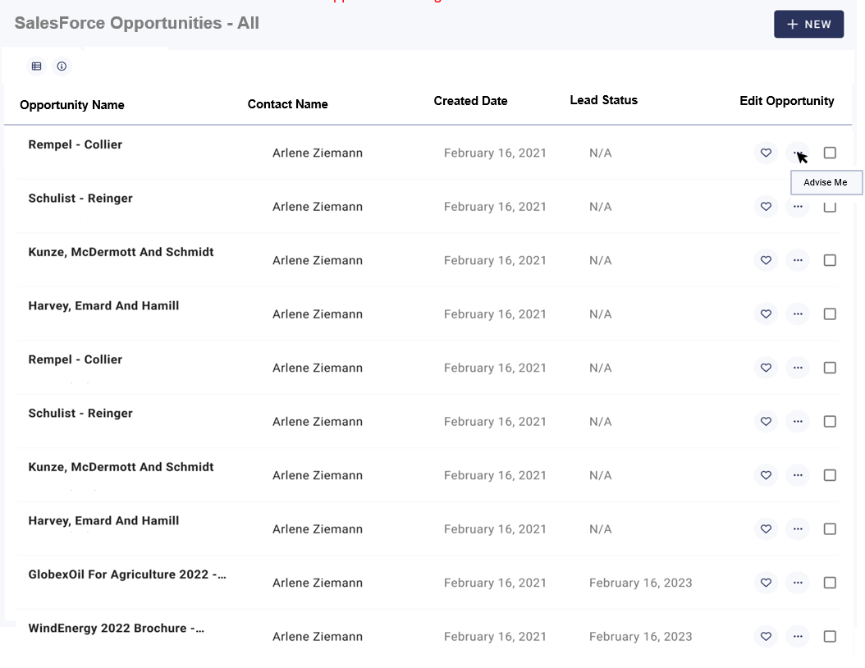
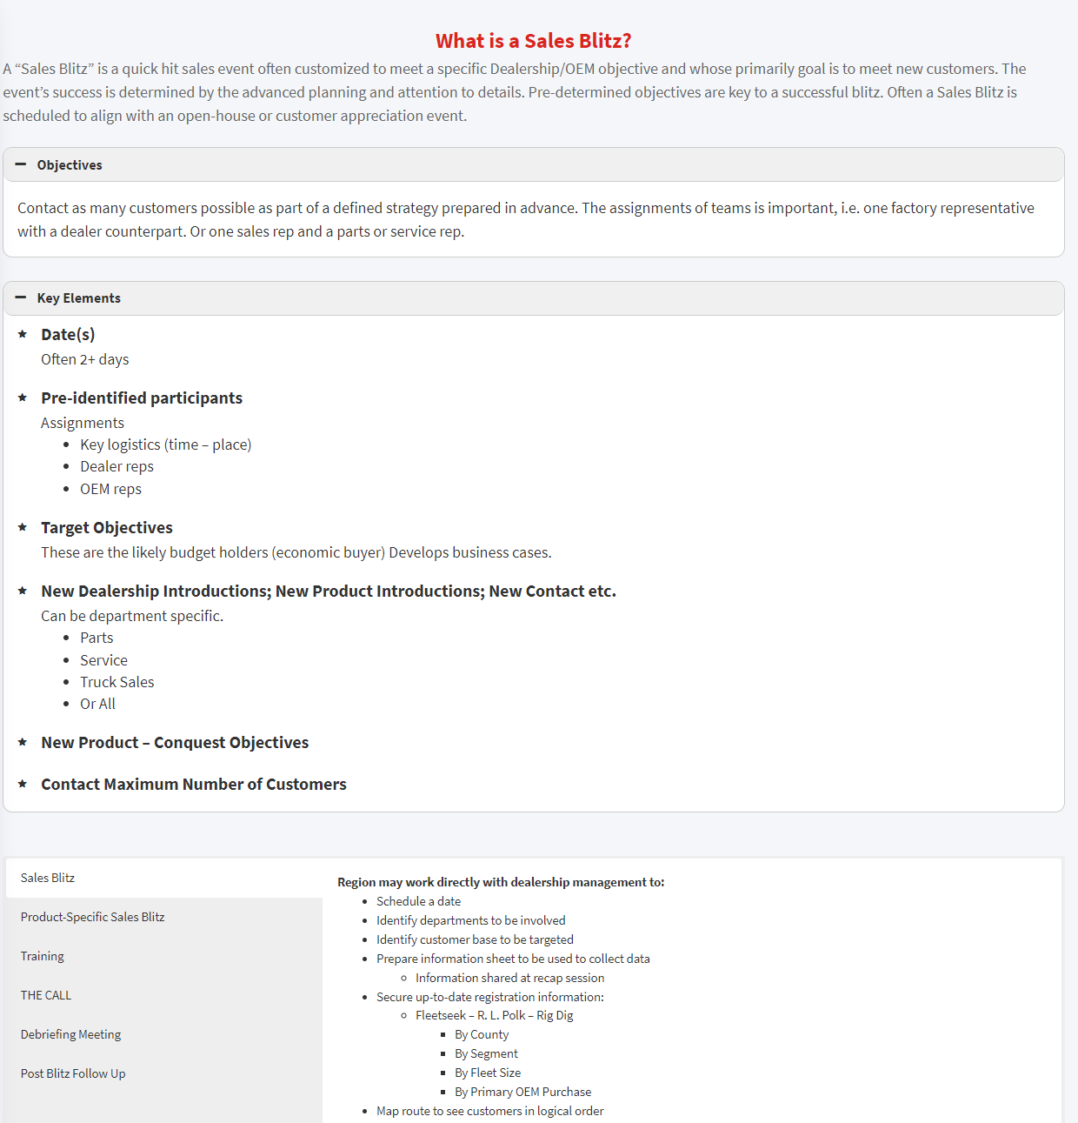
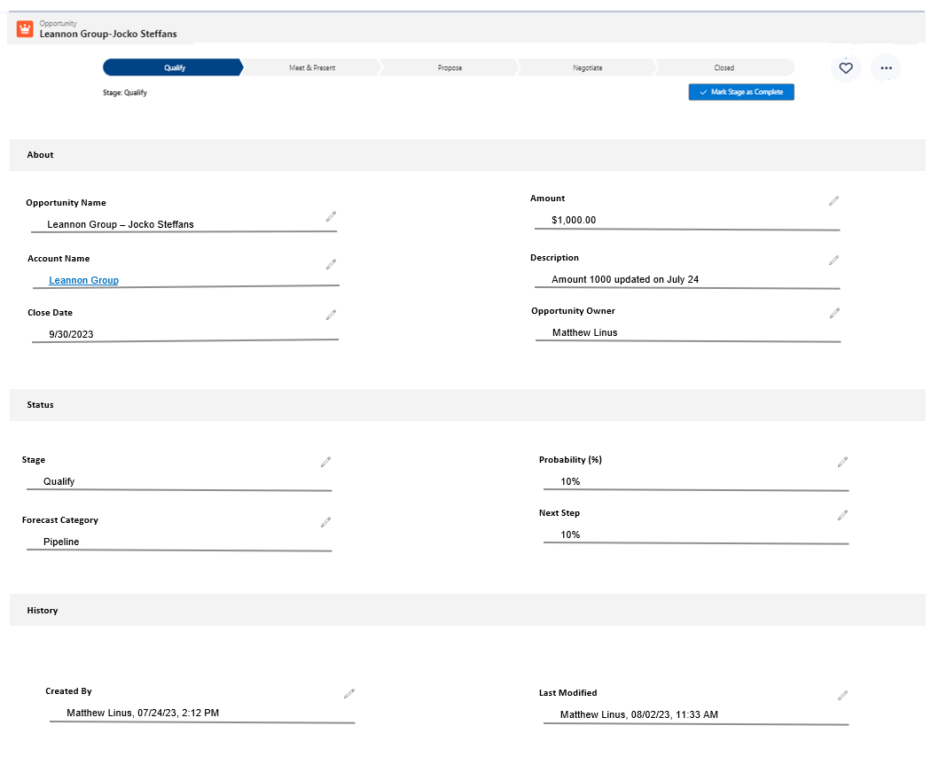
The Pathway to Competency
Engage Sellers
Create Awareness
Promote learning
Ensure Understanding
Facilitate Practice
Support Performance
SUPPORT PERFORMANCE
FACILITATE PRACTICE
ENSURE UNDERSTANDING
PROMOTE
LEARNING
CREATE
AWARENESS
ENGAGE
SELLERS
COMMUNITY
LEARNING
GUIDED PRACTICE
CONTENT IN CONTEXT
COMMUNICATION AND CONTINOUS COACHING
AWARENESS, UNDERSTANDING
& RETENTION
REINFORCEMENT & APPLICATION OF KNOWLEDGE
KNOWLEDGE, CONTENT, TOOLS & ASSISTANCE

Slide 25
Advisory
Services
Engagement
Platform
Readiness
Services
Managed Services
Sales Enablement
Program Admin
Sales Technologies
Learning
Services
Content
Services
Feedback
Data
Analytics

Slide 26

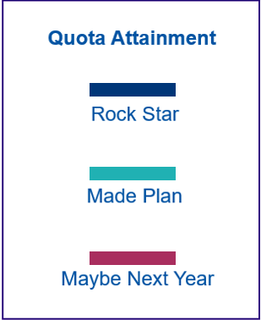
TEG Program Results
The Science of Readiness = Results
100%
27%
39%
51%
Achievement
Made Plan
Almost Not Quite
Maybe Next Year
21%
16%
% of Sellers
52%
50%
46%
18%
31%
0%
Top Third
Mid Third
Bottom Third
LEADERBOARD RANKING
Over 200% increase in team engagement
Average increase in quota achievement of 26% in the first 12 months
*Aggregated data from multiple customers collected from 2017 to 2021

Slide 27




CASE STUDY
How a company improved time-to-competency by shaving one-third (90 days!) off of their sales readiness program - all while increasing retention and productivity
Working with TEG, they reduced their average time-to-sales-productivity by one-third (6 to 9 months became just 120 days) and added three months of additional revenue opportunity development for each newly trained salesperson.
Challenge
Solution
Results
6-9 months for time-to-sales-productivity was too long
Onboarding boring, not applied
Knowledge not easily shared
SMEs too busy to create materials
Training takes too long and is ineffective
Apply pedagogical best practices and deliver consumable content to a community of learners (curation)
Focus on APPLIED learning
Implement TEG’s effective SME content collection methodology
Polish and amplify existing content to make it work
Create fun, engaging learning modules with follow-on learning reinforcements and coaching activities
SME time was optimized
Learners were supported with ongoing learning, coaching, and reinforcements for APPLIED knowledge
Corporate knowledge was preserved and captured, saving company IP
The full 8-part onboarding program plus a robust set of management and AI driven coaching exercises was launched in just 120 days

Slide 28
CASE STUDY
How one company increased engagement and quota achievement by simply curating and communicating critical knowledge already in their organization
Working with TEG, they increased engagement by 300% in the first 90 days, which led to a 26% increase YOY quota achievement
Challenge
Solution
Results
Huge growth: new hires, mergers, big new clients
Content chaos: no one could find the content they needed
Old training tech, redundant and non-productive staff
No standards or templates, content ownership unclear
Unsatisfied and sometimes angry partners
New system to measure engagement, consumption and sharing of content, and coaching
Implemented a continuous publishing “factory” to keep innovative content flowing
Gamified the process and system: loyalty / leaderboard / success
Deliver a HIGHLY engaging SKO
In the first 90 days, engagement +300%
YOY quota achievement of +26% that is still realized today
Sales reduced their time-to-productivity from months to weeks
Organization-wide channel participation increased by 100%
Reduced historical costs by $1M annually
DIY handoff – 36 months

Slide 29
CASE STUDY
How a company accelerated deal flow by delivering a world-class VIP experience for its channel partners
Working with TEG, they accelerated deal flow with an 84% increase in engagement by delivering a program just for channel partners that focused on their customers’ business outcomes to book more 8% POCs and increase revenue by 18%
Challenge
Solution
Results
New LMS highlighted the need for quality content
Playbooks were outdated
Existing content tagged internal-only (not for partners)
Too many internal sales references, selling methodology, and acronyms did not apply
Channel partners didn’t feel “special” and needed attention
Developed a multi-part sales enablement program for partners to accelerate deal flow and close successful POCs
Introduced a training concierge avatar to brand the series
Delivered promo videos, training modules and interactive playbooks tailored to partners
Existing content was polished and “partnerized”
POCs increased 8%
Partner engagement increased 84% in the first six months
Program revenue increased 18% in the first year
Effective knowledge management capture program averages one product per quarter
Request for similar internal programs

Slide 30

Managed Enablement Service
(ACT)
Assess
and Recommend
Goals and Objectives
Current State
Content
People
Process
Plan
Content
People
Process
Create
and Design
Create
Standards
Templates
Processes
Workflows
Design
Community
Experience
Transform
and manage
Implement
Alignment
Governance
Management
Adoption
Communication and Promotion
Training & Support

Slide 31
Sales Enablement Market Opportunity For AI/ML (Use Cases)
Sales readiness (on-boarding, core sales technique training, seller knowledge evaluation, on-going professional skills development & on-going selling coaching)
Sales engagement (account pre-call prep research aggregation/correlation, seller content configuration, guided discovery/selling)

Slide 32
TEG Compliments Tiga Labs Providing (our unique IP):
Experts in sales readiness & engagement
5 core domains of sales enablement knowledge
On-boarding/ever-boarding process
Interactive sales training & engagement playbooks ("the advisor")
Content & relevancy expertise
Training (Aslan selling technique digital content indexed, tagged & embedded)
Pre-call prep research
Curation experts (applying content in right context & cadence)

Slide 33
TEG GTM Support For Tiga Labs GTM: :
Data expertise
Teaching/tuning models
Customer journey data (mapping full marketing/sales funnel)
Sales application mapping (sales engagement content recommendation engine)
B2B MarCom agencies & sales advisory consultants can't help with solution development & GTM
Demo creation
Digital sales coach (sales readiness advisor)
Digital sales assistant (sales pre-call prep & engagement advisor)

Slide 34
TEG GTM Support For Tiga Labs GTM
Sales readiness workshop & content audit (compelling offer of value for initial engagement)
Customer exposure for Tiga Labs
Current TEG customers
Aslan training customers
Brainshark training customers

Slide 35
Our Partnership Request
OEM and API Access to integrate Tiga’s “sales assistant”
OEM for you to our Aslan “Sales Coach” – soon to be AI
OEM for you to our TEG AI “Engagement Advisor” – soon to be AI
25% for our Content Curation Services w/ our Knowledge Network Platform “Doceo”

Slide 36
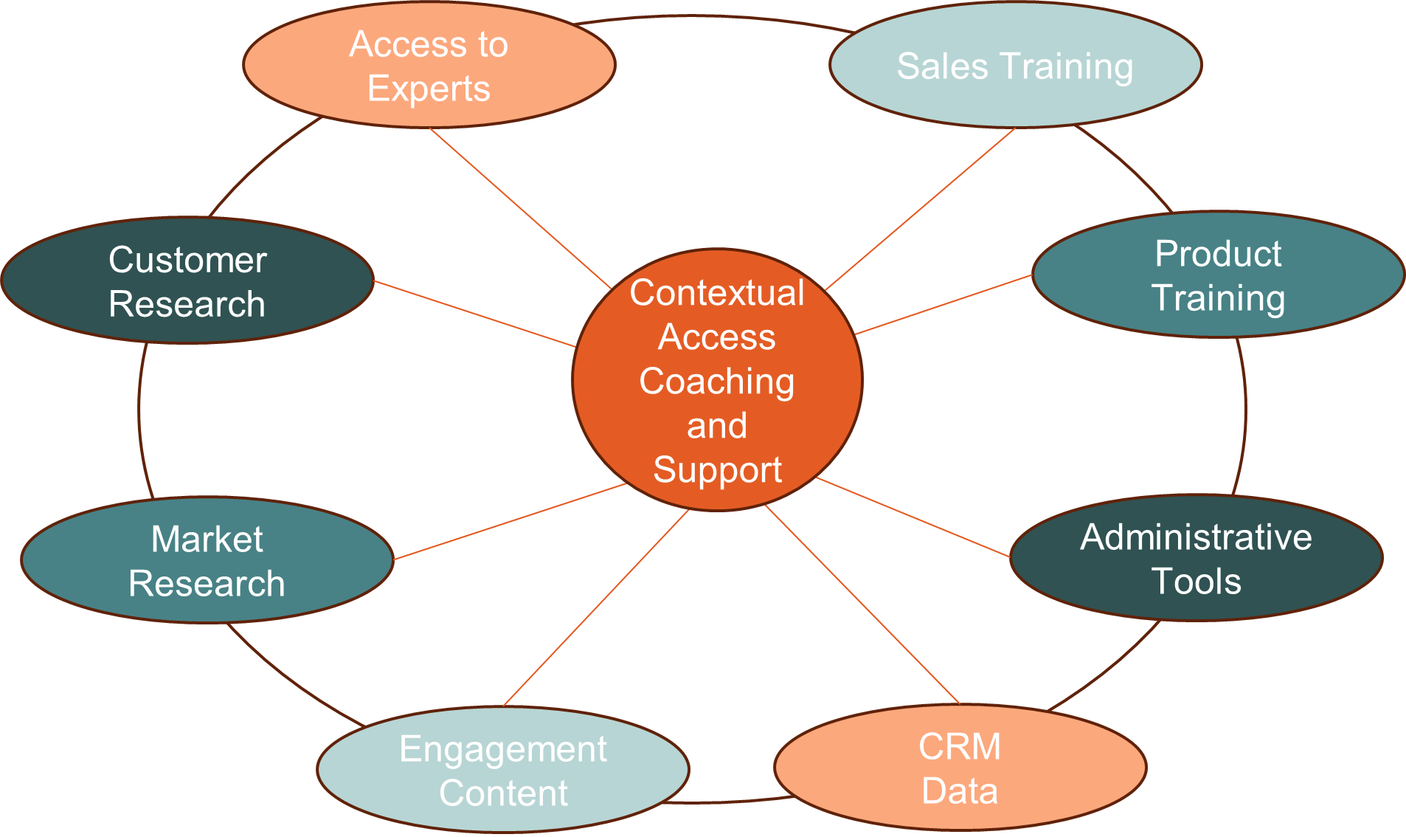
The Sales Knowledge Network

